Slide 1
Community for Emerging and Zoonotic Diseases
Identifying emerging risks through collective intelligence
CEZD – CAHSS Equine Network Update
14 June 2023
www.cezd.ca

Slide 2
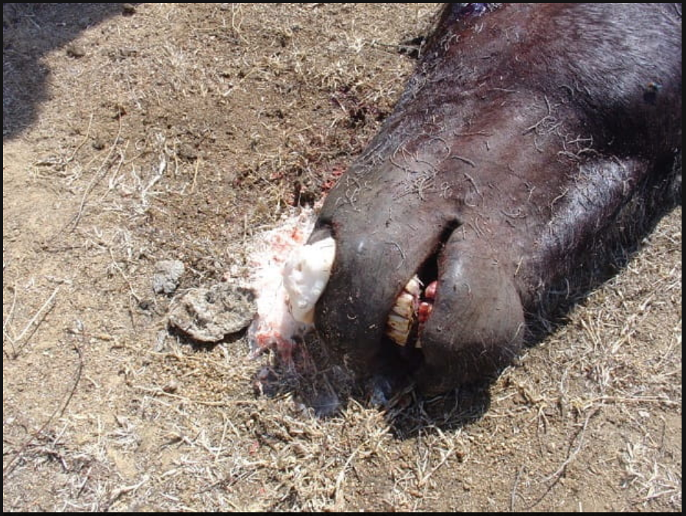
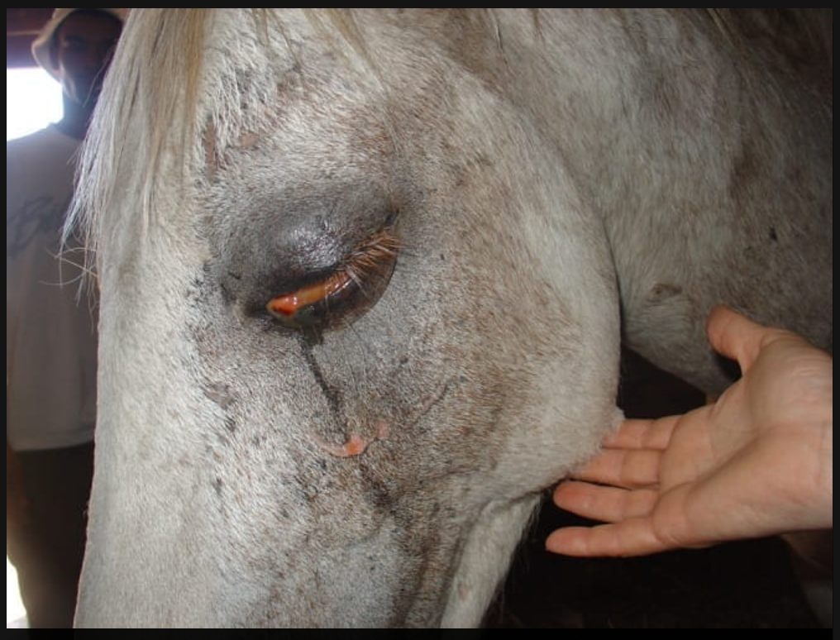
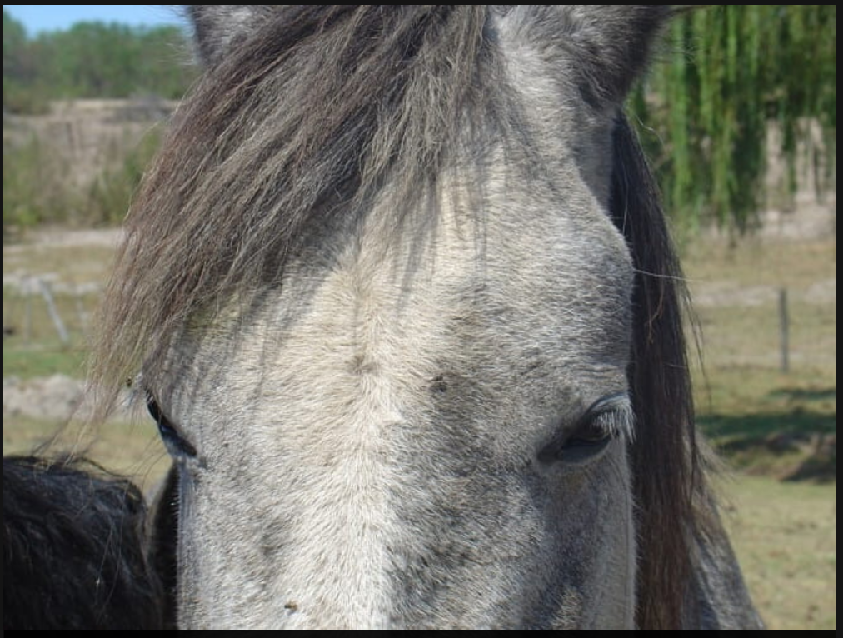
African Horse Sickness
South Africa
Large outbreaks in South Africa have been spreading rapidly Feb-April 2023
Vaccines have not been readily available for AHS and for other animal diseases
Loss of livelihood for many that rely on horses for their work
Images from Merck Veterinary Manual - Dr Camilla Weyer

Slide 3
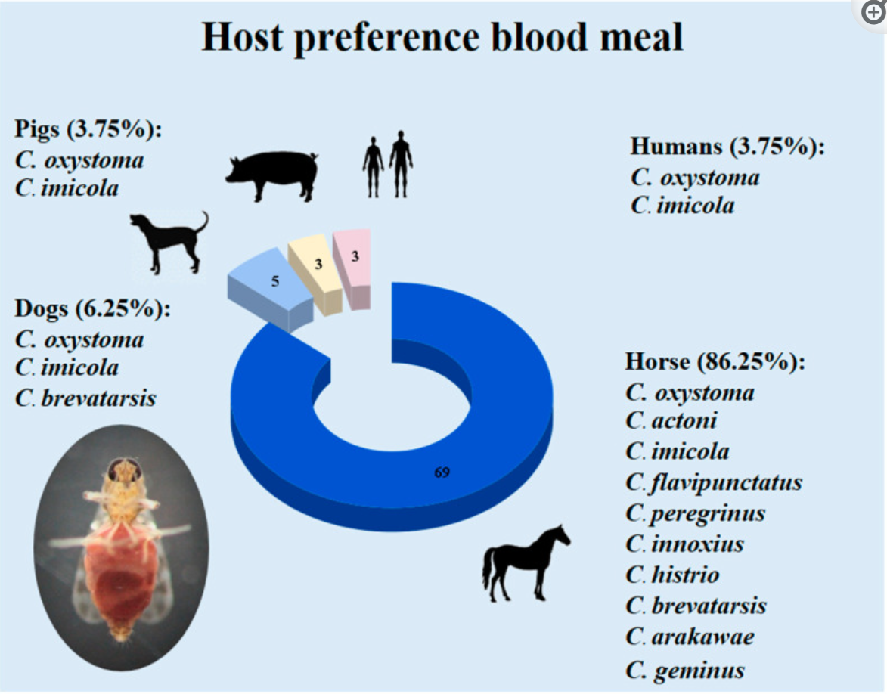
Molecular Identification of Culicoides Species and Host Preference Blood Meal in the African Horse Sickness Outbreak-Affected Area in Hua Hin District, Prachuap Khiri Khan Province, Thailand - PubMed (nih.gov)
Culicoides midges of many species found in Thailand
Trapped Culicoides near 6 horse farms
Genetic analysis of midge species and blood meals to determine host range
Horses were most common host
Dogs, pigs and humans were also common hosts

Slide 4
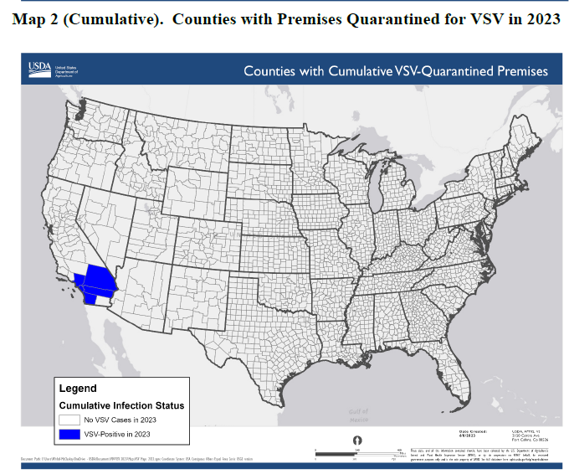
USDA APHIS | Vesicular Stomatitis
Steady increase in cases – 77 as of June 12
  May 17 index case in San Diego county
  May 19 Riverside County
  June 1 San Bernardino County
  June 5 Orange County
  June 8 Los Angeles County
USDA Situation Reports provided publically

Slide 5
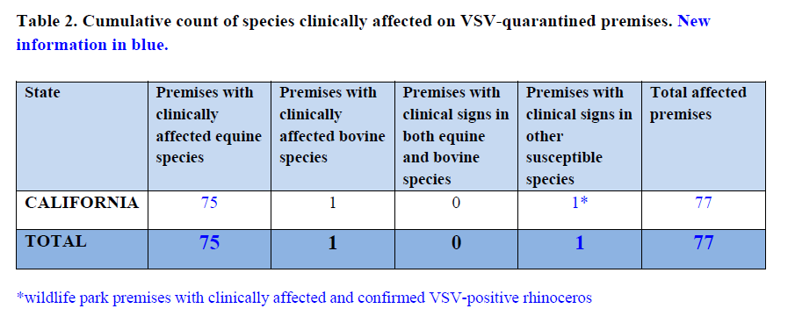
USDA APHIS | Vesicular Stomatitis – Sit Rep June 8 2023

Slide 6
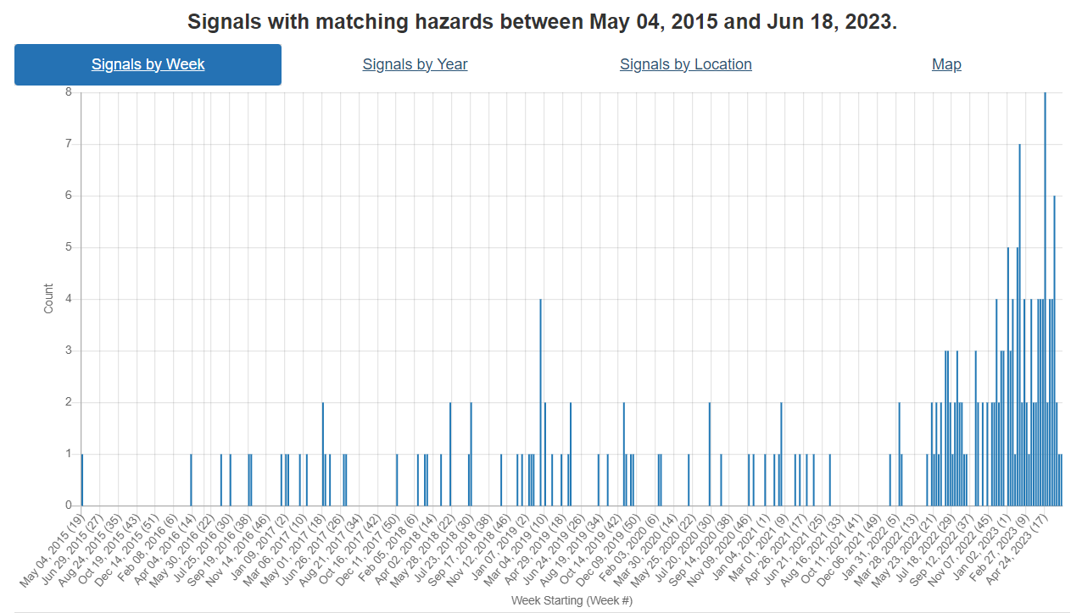
Strangles
Continue to see increased reports of strangles
Virtually all reports in since the last meeting have come from North America
  Ontario, Alberta
  Florida, Michigan, Washington, Kentucky, Missouri, Kansas, Indiana
The increase likely reflects increases in reporting rather than increase in disease as
Strangles is thought to be under reported.

Slide 7
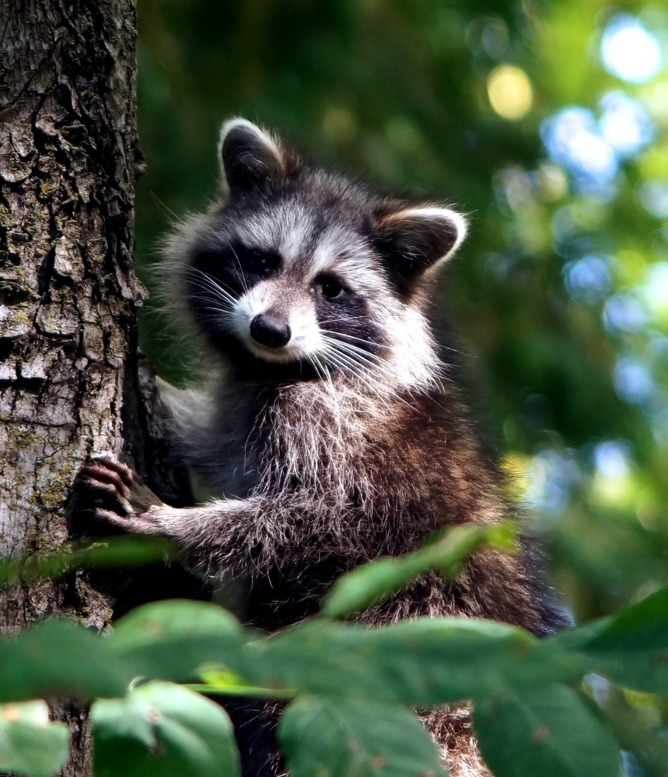
Toronto officials report 117% increase in raccoon bites in 2023 - Outbreak News Today (this does not indicate exposure to rabies)
Rabies
Maine reports increase in Rabies Cases
First rabid moose in state history discovered in Western Alaska (alaskasnewssource.com)

